Slide 1
Character Basic Expression Test
This powerpoint contains the best images generated by Stable Diffusion with the expression they are meant to emulated labeled on top. All text prompting data and other model information such as sampling method and CGF scaling are included in the speaker notes of each slide.

Slide 2
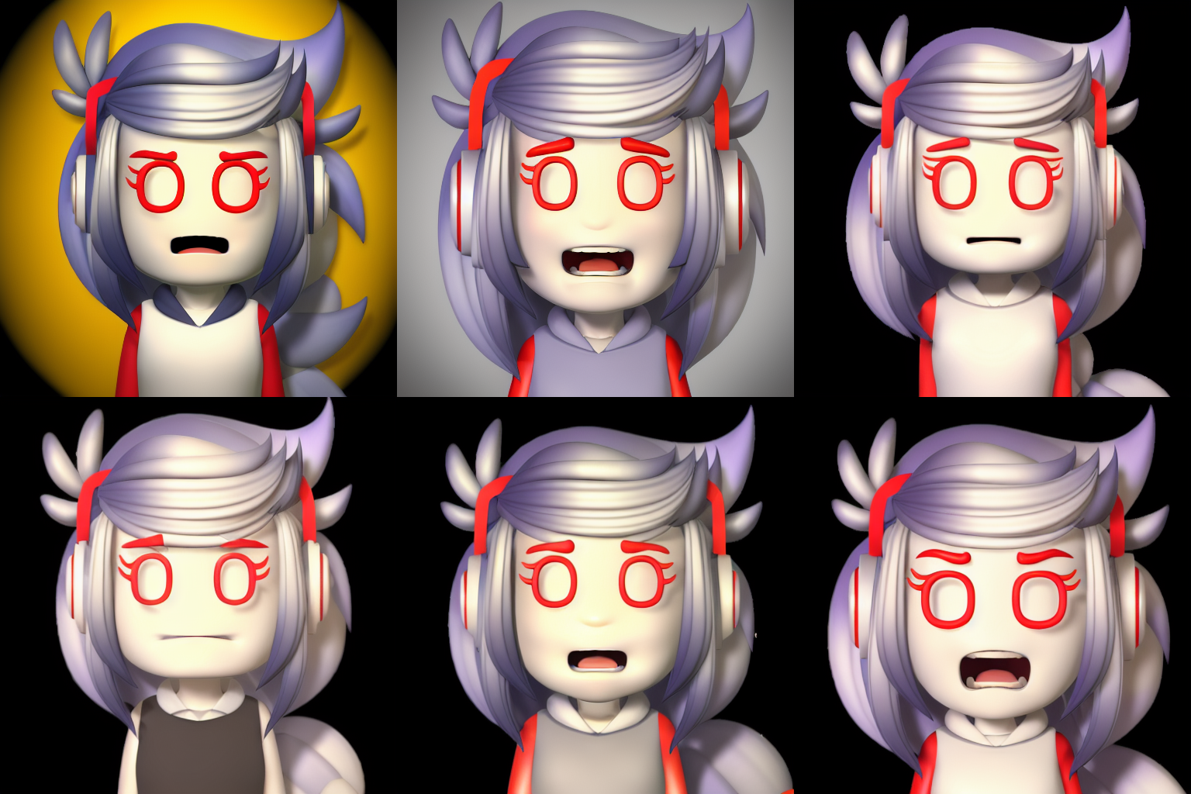
Expression: Anger
Notes:
<lora:A1013D_01-000002:0.7> a cartoon character, (angry:1.5), headshot, mad, anger, frustration, fury, rage, furrowed eye brows, Anime style photo, Manga style, Digital art, glow effects, Hand drawn, render, 8k, octane render, cinema 4d, blender, dark, atmospheric 4k ultra detailed, cinematic sensual, Sharp focus, humorous illustration, hyperrealistic, big depth of field, Masterpiece, colors, 3d octane render, 4k, concept art, trending on artstation, hyperrealistic, Vivid colors,, modelshoot style, (extremely detailed CG unity 8k wallpaper), professional majestic oil painting by Ed Blinkey, Atey Ghailan, Studio Ghibli, by Jeremy Mann, Greg Manchess, Antonio Moro, trending on ArtStation, trending on CGSociety, Intricate, High Detail, Sharp focus, dramatic, photorealistic painting art by midjourney and greg rutkowski
Negative prompt: (nose:2.0), logo, dog, Glasses, Watermark, bad artist, helmet, blur, blurry, text, b&w, 3d, bad art, poorly drawn, disfigured, deformed, extra limbs, ugly hands, extra fingers,, canvas frame, cartoon, 3d, ((disfigured)), ((bad art)), ((deformed)),((extra limbs)),((close up)),((b&w)), weird colors, blurry, (((duplicate))), ((morbid)), ((mutilated)), [out of frame], extra fingers, mutated hands, ((poorly drawn hands)), ((poorly drawn face)), (((mutation))), (((deformed))), ((ugly)), blurry, ((bad anatomy)), (((bad proportions))), ((extra limbs)), cloned face, (((disfigured))), out of frame, ugly, extra limbs, (bad anatomy), gross proportions, (malformed limbs), ((missing arms)), ((missing legs)), (((extra arms))), (((extra legs))), mutated hands, (fused fingers), (too many fingers), (((long neck))), Photoshop, video game, ugly, tiling, poorly drawn hands, poorly drawn feet, poorly drawn face, out of frame, mutation, mutated, extra limbs, extra legs, extra arms, disfigured, deformed, cross-eye, body out of frame, blurry, bad art, bad anatomy, 3d render
Steps: 50, Sampler: Euler a, CFG scale: 7, Seed: 915843624, Size: 512x512, Model hash: 1254103966, Model: protogenV22Anime_22
Time taken: 40.44sTorch active/reserved: 5405/5874 MiB, Sys VRAM: 8192/8192 MiB (100.0%)

Slide 3
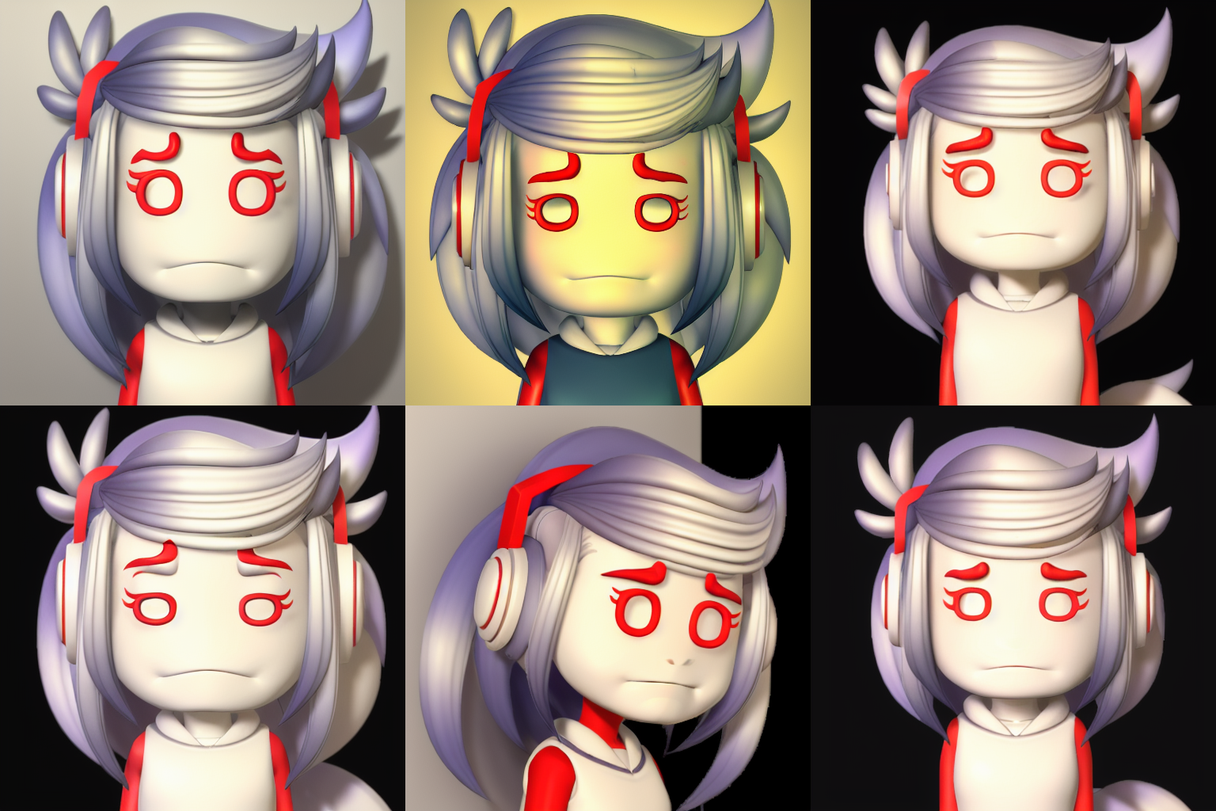
Expression: Sad
Notes:
<lora:A1013D_01-000002:0.7> a cartoon character, (sad:2.0), headshot, depressed, crying, grief, (frowning:1.5), tears, Anime style photo, Manga style, Digital art, glow effects, Hand drawn, render, 8k, octane render, cinema 4d, blender, dark, atmospheric 4k ultra detailed, cinematic sensual, Sharp focus, humorous illustration, hyperrealistic, big depth of field, Masterpiece, colors, 3d octane render, 4k, concept art, trending on artstation, hyperrealistic, Vivid colors,, modelshoot style, (extremely detailed CG unity 8k wallpaper), professional majestic oil painting by Ed Blinkey, Atey Ghailan, Studio Ghibli, by Jeremy Mann, Greg Manchess, Antonio Moro, trending on ArtStation, trending on CGSociety, Intricate, High Detail, Sharp focus, dramatic, photorealistic painting art by midjourney and greg rutkowski
Negative prompt: (nose:2.0), logo, dog, Glasses, Watermark, bad artist, helmet, blur, blurry, text, b&w, 3d, bad art, poorly drawn, disfigured, deformed, extra limbs, ugly hands, extra fingers,, canvas frame, cartoon, 3d, ((disfigured)), ((bad art)), ((deformed)),((extra limbs)),((close up)),((b&w)), weird colors, blurry, (((duplicate))), ((morbid)), ((mutilated)), [out of frame], extra fingers, mutated hands, ((poorly drawn hands)), ((poorly drawn face)), (((mutation))), (((deformed))), ((ugly)), blurry, ((bad anatomy)), (((bad proportions))), ((extra limbs)), cloned face, (((disfigured))), out of frame, ugly, extra limbs, (bad anatomy), gross proportions, (malformed limbs), ((missing arms)), ((missing legs)), (((extra arms))), (((extra legs))), mutated hands, (fused fingers), (too many fingers), (((long neck))), Photoshop, video game, ugly, tiling, poorly drawn hands, poorly drawn feet, poorly drawn face, out of frame, mutation, mutated, extra limbs, extra legs, extra arms, disfigured, deformed, cross-eye, body out of frame, blurry, bad art, bad anatomy, 3d render
Steps: 50, Sampler: Euler a, CFG scale: 7, Seed: 2340057527, Size: 512x512, Model hash: 1254103966, Model: protogenV22Anime_22
Time taken: 39.97sTorch active/reserved: 5405/5874 MiB, Sys VRAM: 8192/8192 MiB (100.0%)

Slide 4
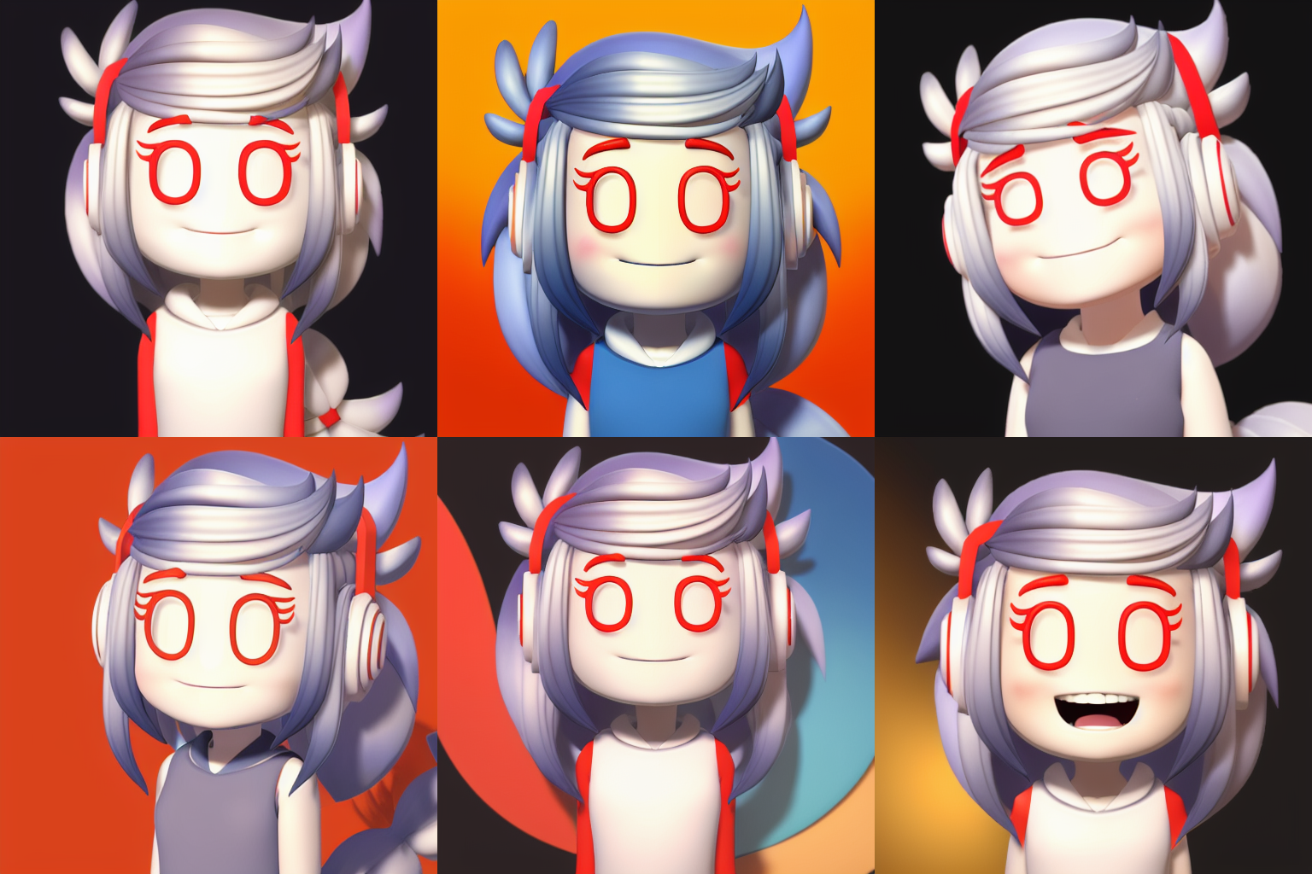
Expression: Happy
Notes:
<lora:A1013D_01-000002:0.7> a cartoon character, (happy:1.5), smiling, Anime style photo, Manga style, Digital art, glow effects, Hand drawn, render, 8k, octane render, cinema 4d, blender, dark, atmospheric 4k ultra detailed, cinematic sensual, Sharp focus, humorous illustration, hyperrealistic, big depth of field, Masterpiece, colors, 3d octane render, 4k, concept art, trending on artstation, hyperrealistic, Vivid colors,, modelshoot style, (extremely detailed CG unity 8k wallpaper), professional majestic oil painting by Ed Blinkey, Atey Ghailan, Studio Ghibli, by Jeremy Mann, Greg Manchess, Antonio Moro, trending on ArtStation, trending on CGSociety, Intricate, High Detail, Sharp focus, dramatic, photorealistic painting art by midjourney and greg rutkowski
Negative prompt: (nose:2.0), logo, dog, Glasses, Watermark, bad artist, helmet, blur, blurry, text, b&w, 3d, bad art, poorly drawn, disfigured, deformed, extra limbs, ugly hands, extra fingers,, canvas frame, cartoon, 3d, ((disfigured)), ((bad art)), ((deformed)),((extra limbs)),((close up)),((b&w)), weird colors, blurry, (((duplicate))), ((morbid)), ((mutilated)), [out of frame], extra fingers, mutated hands, ((poorly drawn hands)), ((poorly drawn face)), (((mutation))), (((deformed))), ((ugly)), blurry, ((bad anatomy)), (((bad proportions))), ((extra limbs)), cloned face, (((disfigured))), out of frame, ugly, extra limbs, (bad anatomy), gross proportions, (malformed limbs), ((missing arms)), ((missing legs)), (((extra arms))), (((extra legs))), mutated hands, (fused fingers), (too many fingers), (((long neck))), Photoshop, video game, ugly, tiling, poorly drawn hands, poorly drawn feet, poorly drawn face, out of frame, mutation, mutated, extra limbs, extra legs, extra arms, disfigured, deformed, cross-eye, body out of frame, blurry, bad art, bad anatomy, 3d render
Steps: 50, Sampler: Euler a, CFG scale: 7, Seed: 963170150, Size: 512x512, Model hash: 1254103966, Model: protogenV22Anime_22

Slide 5
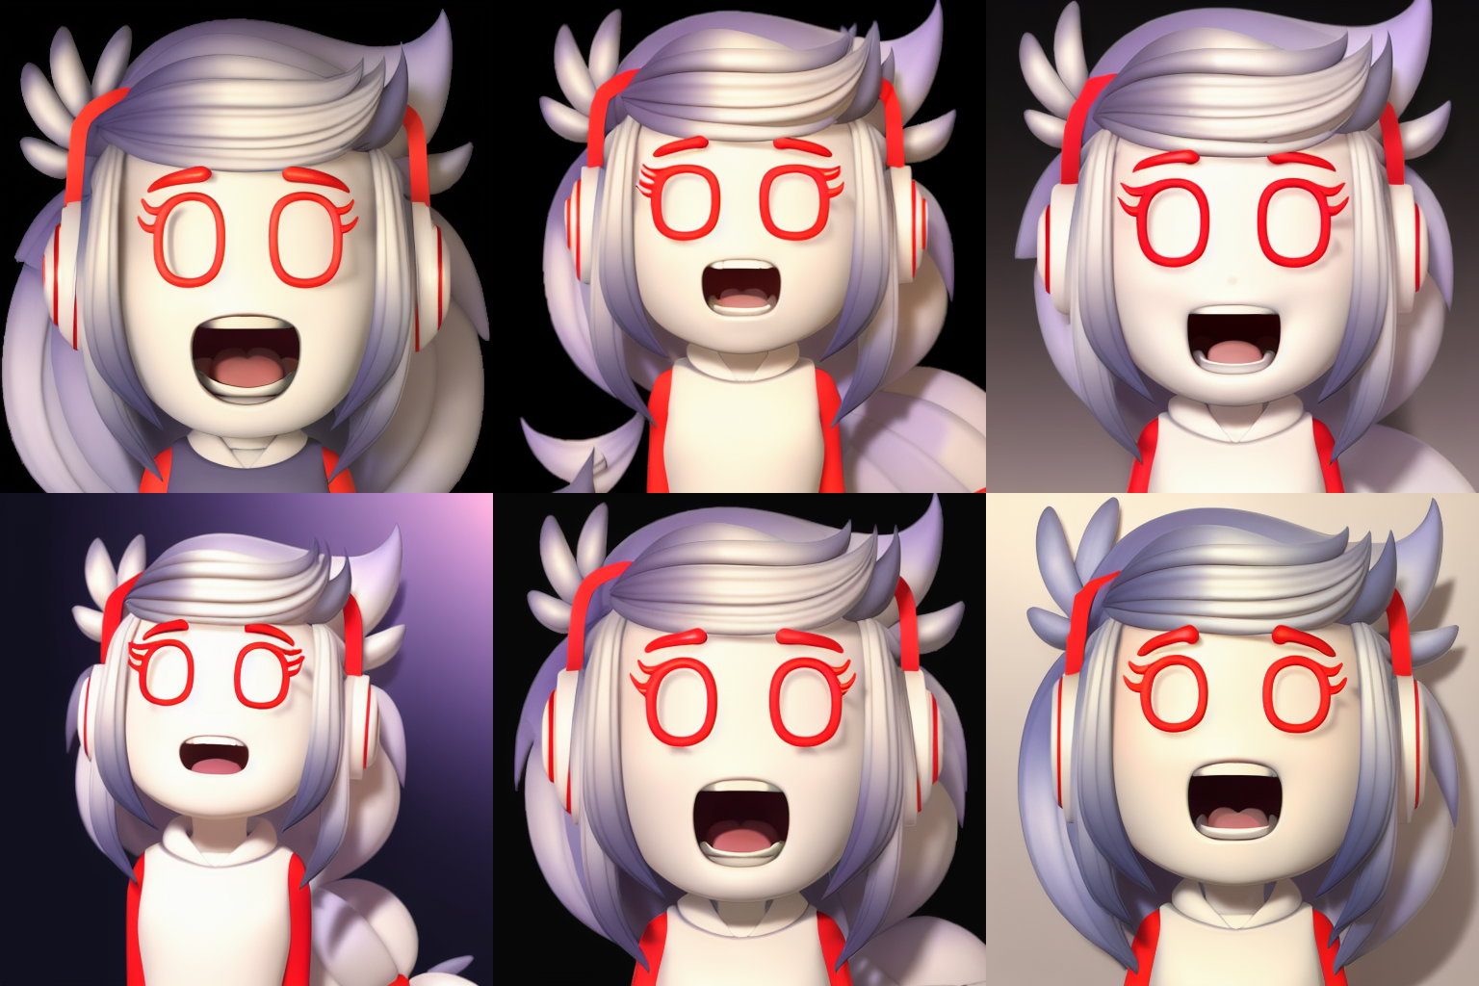
Expression: Surprise
Notes:
<lora:A1013D_01-000002:0.7> a cartoon character, (surprise:1.5), mouth open wide, eyes open wide, brows raised, Anime style photo, Manga style, Digital art, glow effects, Hand drawn, render, 8k, octane render, cinema 4d, blender, dark, atmospheric 4k ultra detailed, cinematic sensual, Sharp focus, humorous illustration, hyperrealistic, big depth of field, Masterpiece, colors, 3d octane render, 4k, concept art, trending on artstation, hyperrealistic, Vivid colors,, modelshoot style, (extremely detailed CG unity 8k wallpaper), professional majestic oil painting by Ed Blinkey, Atey Ghailan, Studio Ghibli, by Jeremy Mann, Greg Manchess, Antonio Moro, trending on ArtStation, trending on CGSociety, Intricate, High Detail, Sharp focus, dramatic, photorealistic painting art by midjourney and greg rutkowski
Negative prompt: (nose:2.0), logo, dog, Glasses, Watermark, bad artist, helmet, blur, blurry, text, b&w, 3d, bad art, poorly drawn, disfigured, deformed, extra limbs, ugly hands, extra fingers,, canvas frame, cartoon, 3d, ((disfigured)), ((bad art)), ((deformed)),((extra limbs)),((close up)),((b&w)), weird colors, blurry, (((duplicate))), ((morbid)), ((mutilated)), [out of frame], extra fingers, mutated hands, ((poorly drawn hands)), ((poorly drawn face)), (((mutation))), (((deformed))), ((ugly)), blurry, ((bad anatomy)), (((bad proportions))), ((extra limbs)), cloned face, (((disfigured))), out of frame, ugly, extra limbs, (bad anatomy), gross proportions, (malformed limbs), ((missing arms)), ((missing legs)), (((extra arms))), (((extra legs))), mutated hands, (fused fingers), (too many fingers), (((long neck))), Photoshop, video game, ugly, tiling, poorly drawn hands, poorly drawn feet, poorly drawn face, out of frame, mutation, mutated, extra limbs, extra legs, extra arms, disfigured, deformed, cross-eye, body out of frame, blurry, bad art, bad anatomy, 3d render
Steps: 50, Sampler: Euler a, CFG scale: 7, Seed: 1106110604, Size: 512x512, Model hash: 1254103966, Model: protogenV22Anime_22

Slide 6
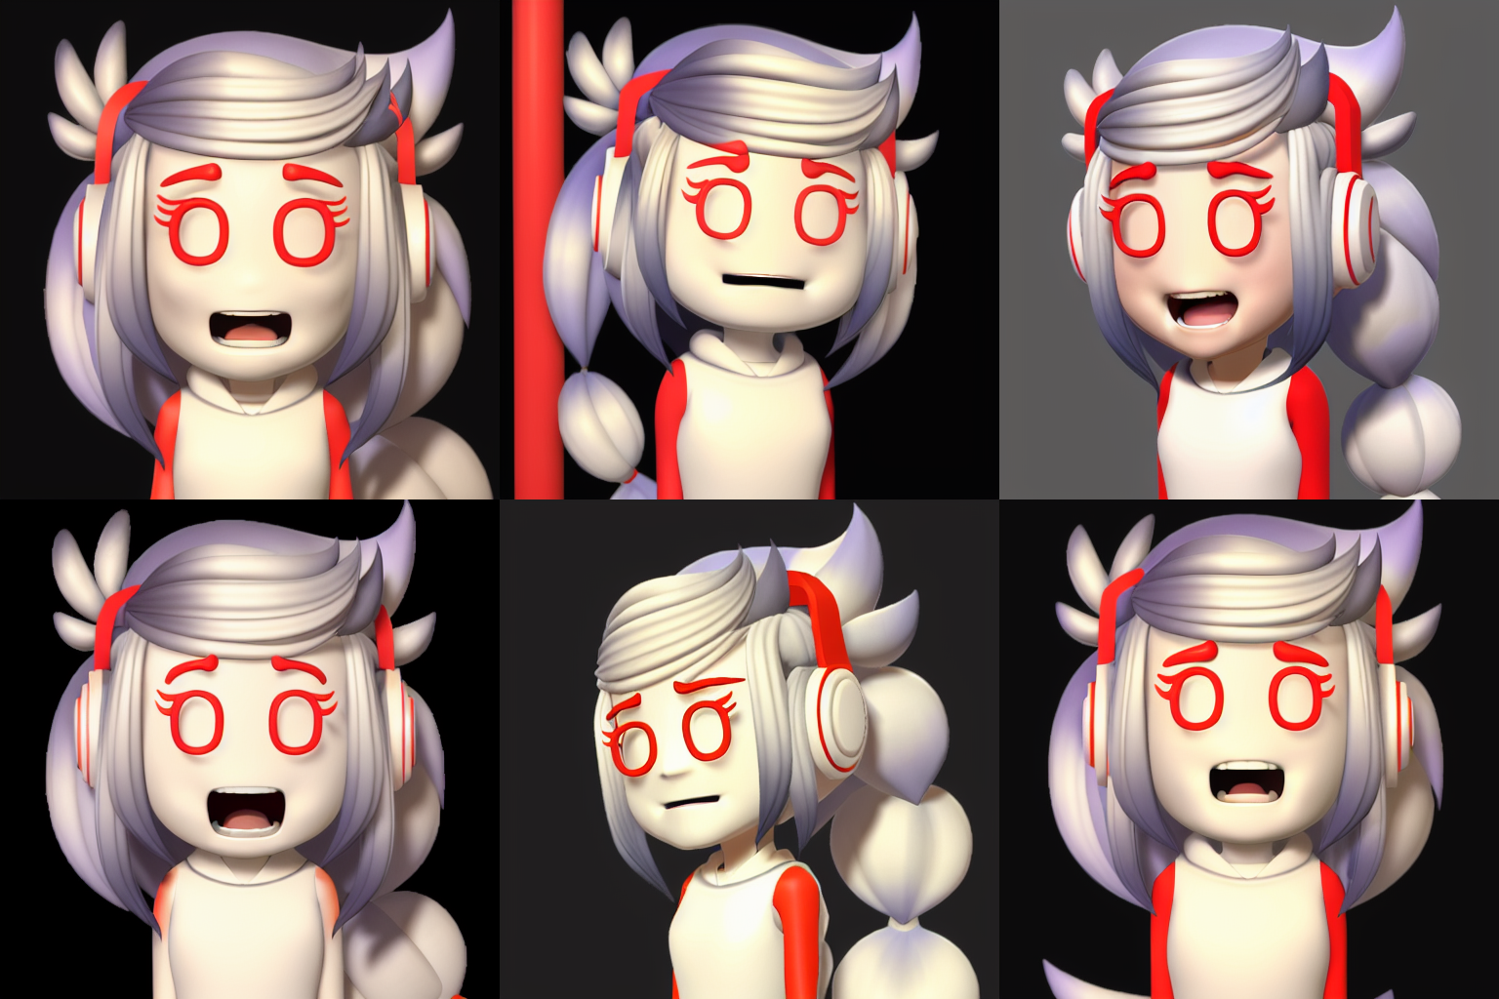
Expression: Disgust
Notes:
<lora:A1013D_01-000002:0.7> a cartoon character, (disgust:1.6), eyes narrowed in disgust, tongue sticking out in disgust, (scrunched face:1.2), mouth open slightly frowning in disgust, lowered brows,, Anime style photo, Manga style, Digital art, glow effects, Hand drawn, render, 8k, octane render, cinema 4d, blender, dark, atmospheric 4k ultra detailed, cinematic sensual, Sharp focus, humorous illustration, hyperrealistic, big depth of field, Masterpiece, colors, 3d octane render, 4k, concept art, trending on artstation, hyperrealistic, Vivid colors,, modelshoot style, (extremely detailed CG unity 8k wallpaper), professional majestic oil painting by Ed Blinkey, Atey Ghailan, Studio Ghibli, by Jeremy Mann, Greg Manchess, Antonio Moro, trending on ArtStation, trending on CGSociety, Intricate, High Detail, Sharp focus, dramatic, photorealistic painting art by midjourney and greg rutkowski
Negative prompt: (nose:2.0), logo, dog, Glasses, Watermark, bad artist, helmet, blur, blurry, text, b&w, 3d, bad art, poorly drawn, disfigured, deformed, extra limbs, ugly hands, extra fingers,, canvas frame, cartoon, 3d, ((disfigured)), ((bad art)), ((deformed)),((extra limbs)),((close up)),((b&w)), weird colors, blurry, (((duplicate))), ((morbid)), ((mutilated)), [out of frame], extra fingers, mutated hands, ((poorly drawn hands)), ((poorly drawn face)), (((mutation))), (((deformed))), ((ugly)), blurry, ((bad anatomy)), (((bad proportions))), ((extra limbs)), cloned face, (((disfigured))), out of frame, ugly, extra limbs, (bad anatomy), gross proportions, (malformed limbs), ((missing arms)), ((missing legs)), (((extra arms))), (((extra legs))), mutated hands, (fused fingers), (too many fingers), (((long neck))), Photoshop, video game, ugly, tiling, poorly drawn hands, poorly drawn feet, poorly drawn face, out of frame, mutation, mutated, extra limbs, extra legs, extra arms, disfigured, deformed, cross-eye, body out of frame, blurry, bad art, bad anatomy, 3d render
Steps: 50, Sampler: Euler a, CFG scale: 7, Seed: 1288127682, Size: 512x512, Model hash: 1254103966, Model: protogenV22Anime_22
Time taken: 42.04sTorch active/reserved: 5405/5874 MiB, Sys VRAM: 8192/8192 MiB (100.0%)

Slide 7
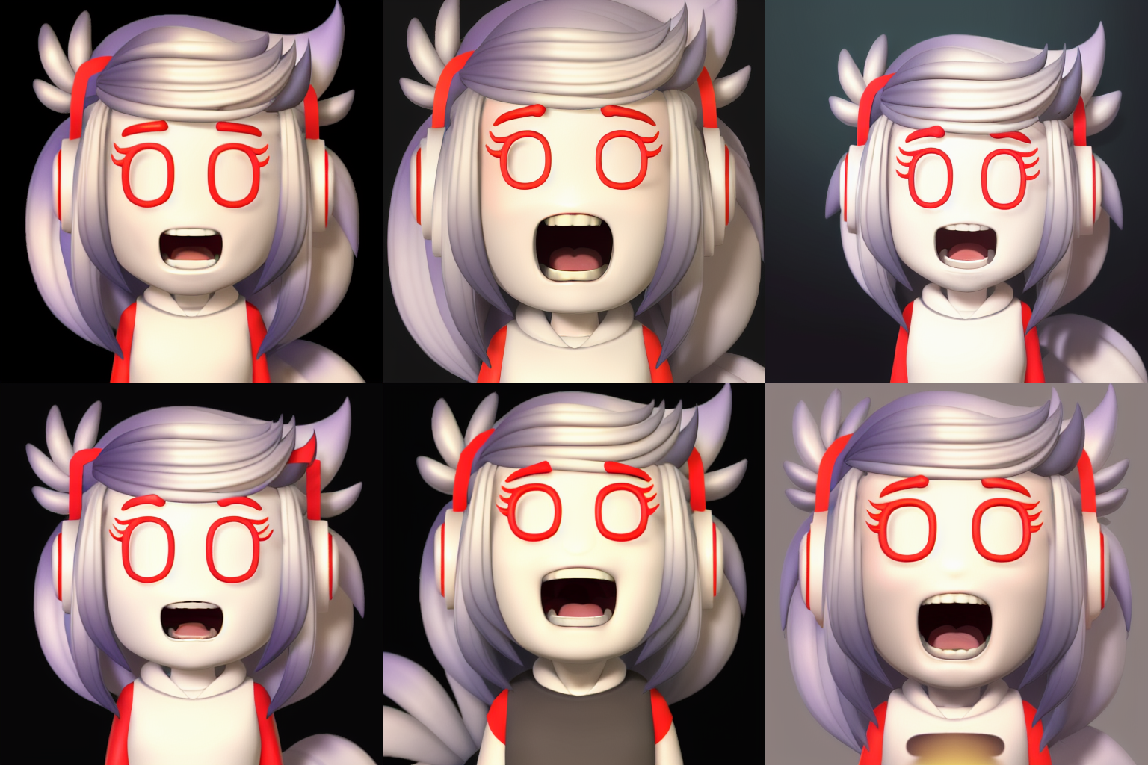
Expression: Fear
Notes:
<lora:A1013D_01-000002:0.7> a cartoon character, (eyes open wide:1.2), brows raised, mouth open wide, (fear:1.8), (scared:1.2), terrified, terror, afraid, Anime style photo, Manga style, Digital art, glow effects, Hand drawn, render, 8k, octane render, cinema 4d, blender, dark, atmospheric 4k ultra detailed, cinematic sensual, Sharp focus, humorous illustration, hyperrealistic, big depth of field, Masterpiece, colors, 3d octane render, 4k, concept art, trending on artstation, hyperrealistic, Vivid colors,, modelshoot style, (extremely detailed CG unity 8k wallpaper), professional majestic oil painting by Ed Blinkey, Atey Ghailan, Studio Ghibli, by Jeremy Mann, Greg Manchess, Antonio Moro, trending on ArtStation, trending on CGSociety, Intricate, High Detail, Sharp focus, dramatic, photorealistic painting art by midjourney and greg rutkowski
Negative prompt: (nose:2.0), logo, dog, Glasses, Watermark, bad artist, helmet, blur, blurry, text, b&w, 3d, bad art, poorly drawn, disfigured, deformed, extra limbs, ugly hands, extra fingers,, canvas frame, cartoon, 3d, ((disfigured)), ((bad art)), ((deformed)),((extra limbs)),((close up)),((b&w)), weird colors, blurry, (((duplicate))), ((morbid)), ((mutilated)), [out of frame], extra fingers, mutated hands, ((poorly drawn hands)), ((poorly drawn face)), (((mutation))), (((deformed))), ((ugly)), blurry, ((bad anatomy)), (((bad proportions))), ((extra limbs)), cloned face, (((disfigured))), out of frame, ugly, extra limbs, (bad anatomy), gross proportions, (malformed limbs), ((missing arms)), ((missing legs)), (((extra arms))), (((extra legs))), mutated hands, (fused fingers), (too many fingers), (((long neck))), Photoshop, video game, ugly, tiling, poorly drawn hands, poorly drawn feet, poorly drawn face, out of frame, mutation, mutated, extra limbs, extra legs, extra arms, disfigured, deformed, cross-eye, body out of frame, blurry, bad art, bad anatomy, 3d render
Steps: 50, Sampler: Euler a, CFG scale: 7, Seed: 4096675557, Size: 512x512, Model hash: 1254103966, Model: protogenV22Anime_22
Time taken: 40.12sTorch active/reserved: 5405/5874 MiB, Sys VRAM: 8192/8192 MiB (100.0%)

Slide 8
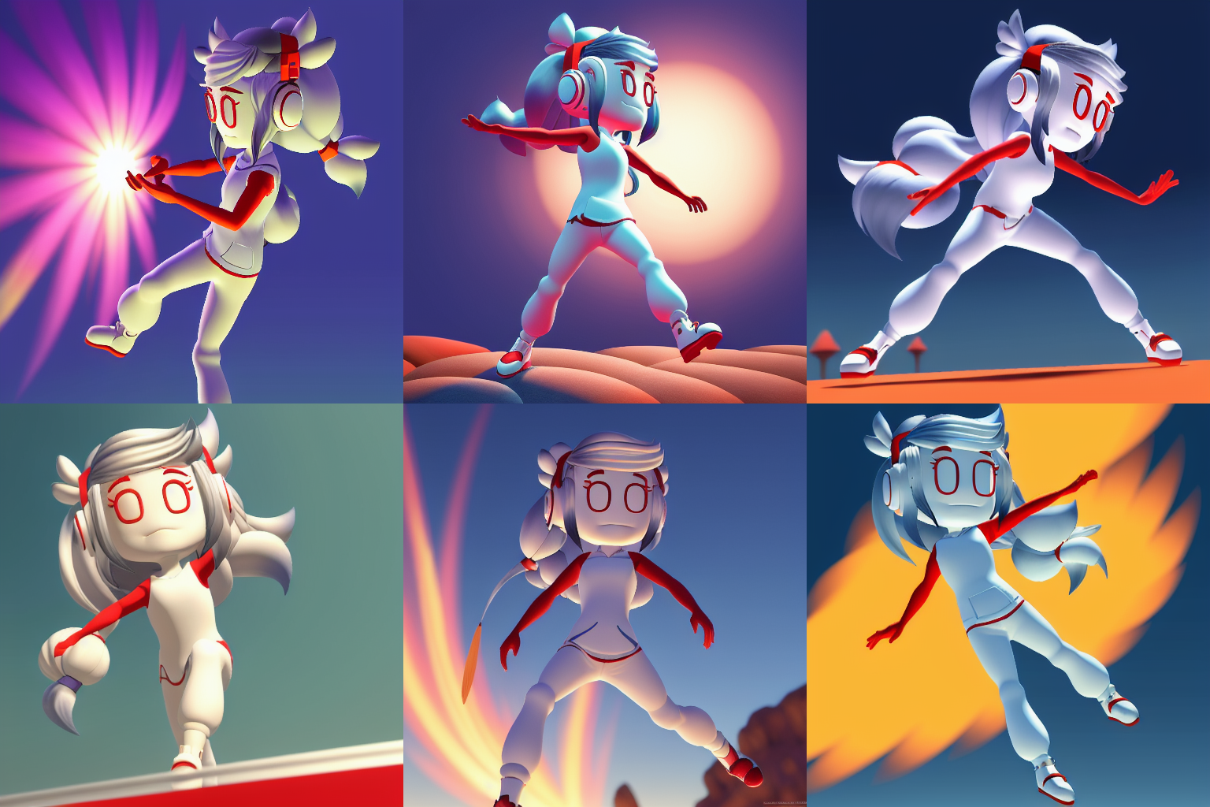
Bonus Expression: Full Body Movement
Notes:
<lora:A1013D_01-000002:0.7> a cartoon character, full body moving, hair moving in the wind, Anime style photo, Manga style, Digital art, glow effects, Hand drawn, render, 8k, octane render, cinema 4d, blender, dark, atmospheric 4k ultra detailed, cinematic sensual, Sharp focus, humorous illustration, hyperrealistic, big depth of field, Masterpiece, colors, 3d octane render, 4k, concept art, trending on artstation, hyperrealistic, Vivid colors,, modelshoot style, (extremely detailed CG unity 8k wallpaper), professional majestic oil painting by Ed Blinkey, Atey Ghailan, Studio Ghibli, by Jeremy Mann, Greg Manchess, Antonio Moro, trending on ArtStation, trending on CGSociety, Intricate, High Detail, Sharp focus, dramatic, photorealistic painting art by midjourney and greg rutkowski
Negative prompt: (nose:2.0), logo, dog, Glasses, Watermark, bad artist, helmet, blur, blurry, text, b&w, 3d, bad art, poorly drawn, disfigured, deformed, extra limbs, ugly hands, extra fingers,, canvas frame, cartoon, 3d, ((disfigured)), ((bad art)), ((deformed)),((extra limbs)),((close up)),((b&w)), weird colors, blurry, (((duplicate))), ((morbid)), ((mutilated)), [out of frame], extra fingers, mutated hands, ((poorly drawn hands)), ((poorly drawn face)), (((mutation))), (((deformed))), ((ugly)), blurry, ((bad anatomy)), (((bad proportions))), ((extra limbs)), cloned face, (((disfigured))), out of frame, ugly, extra limbs, (bad anatomy), gross proportions, (malformed limbs), ((missing arms)), ((missing legs)), (((extra arms))), (((extra legs))), mutated hands, (fused fingers), (too many fingers), (((long neck))), Photoshop, video game, ugly, tiling, poorly drawn hands, poorly drawn feet, poorly drawn face, out of frame, mutation, mutated, extra limbs, extra legs, extra arms, disfigured, deformed, cross-eye, body out of frame, blurry, bad art, bad anatomy, 3d render
Steps: 50, Sampler: Euler a, CFG scale: 7, Seed: 2388165376, Size: 512x512, Model hash: 1254103966, Model: protogenV22Anime_22
Time taken: 39.41sTorch active/reserved: 5405/5874 MiB, Sys VRAM: 8192/8192 MiB (100.0%)

